Slide 1
How can researchers effectively convey scientific knowledge outside the academic community?
Tove Kolset
Senior Communications Adviser, NIPH
26.03.2015

Slide 2
Who am I to talk?
Svalbard, 2010
Worked in science communication for 28 years:
NORUT Northern Research Institute, Tromsø
UCSD, California San Diego
Norwegian Cancer Society, Oslo
Dagbladet, Oslo
CICERO Center for International Climate and
Environmental Research, Oslo
Norwegian Institute of Public Health/
Norwegian Mother and Child Cohort Study
Notes:
I am very happy to be here to day.
They say that the slot after lunch is the more demanding.
All blood goes from the head to the stomack to help digestion.
We take that as a challenge!
Go through and tell about my positions etc

Slide 3
What am I going to talk about
Why science communication
Science communication – Three models
How can researchers make the most of the different models in order to communicate EFFECTIVELY
…. BUT within the framework of their workplace?
…. AND what about the researcher as as a member of civil society communicating outside her own research area?
Practical examples throughout
Take home message and discussion
Notes:
Just interrupt me as I go along and ask questions if anything is unclear. And remember to save some questions for the discussion afterwards.

Slide 4
Why science communication?
Universiteter og høyskoler er pålagt ved lov å formidle kunnskap om virksomheten og utbre forståelse for prinsippet om faglig frihet og anvendelse av vitenskapelige og kunstneriske metoder og resultater. Det gjelder både i undervisningen av studenter og i formidling rettet mot samfunnet. Formidlingsansvaret ble utvidet og styrket ved revisjon av lov om universiteter og høyskoler i 2003.
I 2011 ble det registrert 19 700 ulike formidlingsbidrag fra universiteter og høyskoler, en økning på 16 prosent fra året før. Økningen skyldes ikke nødvendigvis økt formidlingsaktivitet, men kan like gjerne være et resultat av mer aktiv bruk av CRIStin. Uansett viser tallene at forskere ved norske læresteder er aktive forskningsformidlere. Den hyppigst rapporterte aktiviteten er intervju i mediene, etterfulgt av konferansebidrag/foredrag.
Fra Meld. St. 18 (2012–2013) «Lange linjer – kunnskap gir muligheter»
Notes:
I start with an example of how not to use powerpoint. You don’t have to read it, but I shall translate the message in read!
80 per cent of research dissemination is made by 20 per cent of the scientists!

Slide 5
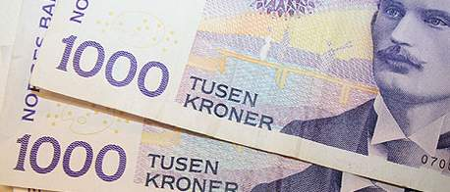
Why science communication?
In addition: Public Relations and marketing
Dilemma:
«Mål, retning og handlingsparametere ble nedfelt i avdelingens strategi, samtidig som det ble klargjort at avdelingens rolle ikke er å markedsføre UiB. Dersom vi skal sikre oss integritet i den type formidling vi driver, kan ikke avdelingen ha et markedsansvar. Samtidig er vi heldige som har en profesjonell, kompetent ledelse ved UiB.»
(Interview with the former communication director Torny Aarbakke, UiB, in the magazine Kommunikasjon, 2005)

Slide 6
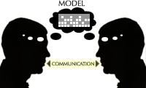
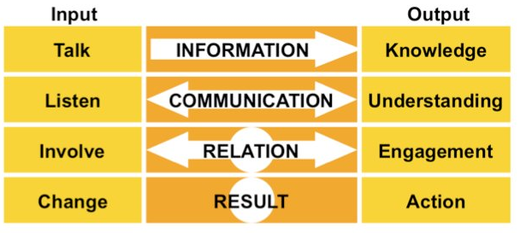
Communication models
The Classical Linear Dissimination Model
The Interactive Communication Model
The Transactional Communication Model

Slide 7
The Classical Linear Dissemination Model
Most frequently used model
The term «research dissemination» is more common than «research communication»
Disseminate rules communicate
Convey (e.g. title) rules interact/involve

Slide 8
The Classical Linear Dissemination Model
Model: Shannon and Weaver 1949

Slide 9
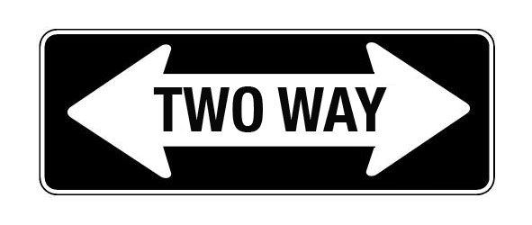
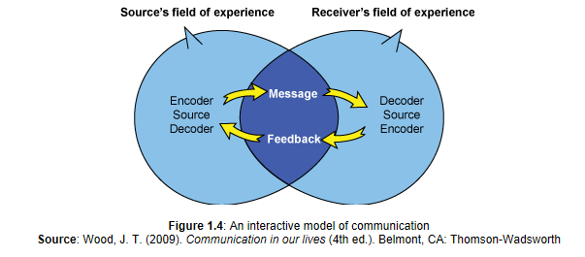
The Interactive Communication Model

Slide 10
The Interactive Communication Model
This model came into more frequent use in the 1990’s
New incentives for government to communicate with researchers, professional users and end users
New information technology
Criticism: Superficiality and «mock democray»
More demanding and time consuming than the linear communication model

Slide 11
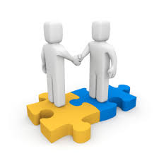
The Transactional Communication Model
Notes:
Transaction stems from latin and it has focus on change: Force something to happen. It assumes that people are connected through communication; they engage in transaction. First, it recognizes that each of us is a sender-receiver, not merely a sender or a receiver. Secondly, it recognizes that communication affects all parties involved. So communication is fluid/simultaneous. This is what most conversations are like. The The transactional model also contains ellipses that symbolize the communication environment (how you interpret the data that you are given). Where the ellipses meet is the most effective communication area because both communicators share the same meaning of the message.

Slide 12
The Transactional Communication Model
Learning together
Communication and interaction with users, decision makers and researchers
In Norway, one example often highlighted: farmers in experimental testing of new production methods together with government and reseachers
User participation (brukermedvirkning) in research projects
Clearly the most advanced form of communication
May be time consuming, but still may be worth it

Slide 13
When to use the Classical Linear Dissemination Model
Always, regardless of models:
know what you want to say (message), to whom (target group), when (pick the right moment), where (channel) and why (perhaps you shouldn’t?)
What is the story you want to tell
Always: Avoid «tribe language»

Slide 14
When to use the Classical Linear Dissemination Model
The most used model even today
The «one-to-many» principle – mass communication
Educated target group (reduced noise/easier to reach by mass communication)
When time is of essence (eg crisis)
«Push» and «pull» communication channels

Slide 15
The «one-to-many» principle
Newspaper article, web article
magazine article, radio, television
Talk to a journalist
What: New project, results, expert comment
Whom: General audience
When: Have a «peg»/actuality
Where: Focal point and target group of mass media differ. Get to know some journalists interested in your field

Slide 16
The «one-to-many» principle
Pitfalls: Difference between science journalism and science communication – understand your role and the journalist’s role and dramaturgy
Practise and work together with a communication officer
Use forskning.no (UiB is a member)
Research programs in TV/radio and columns in newspapers/net

Slide 17
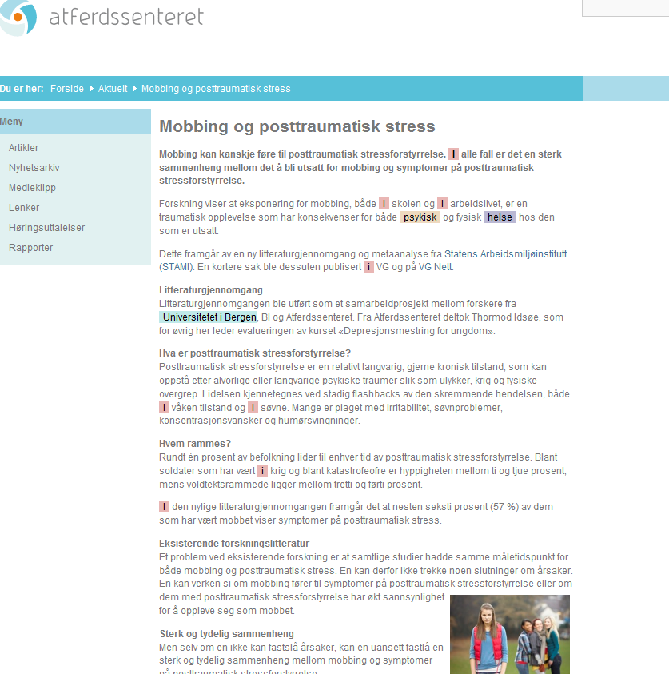
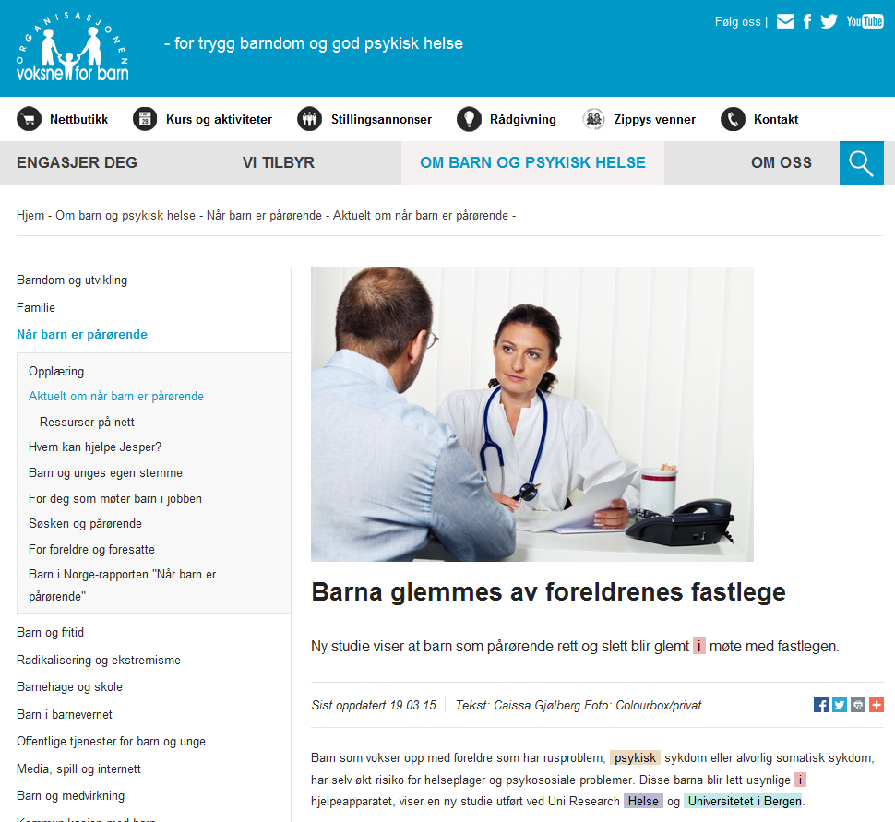
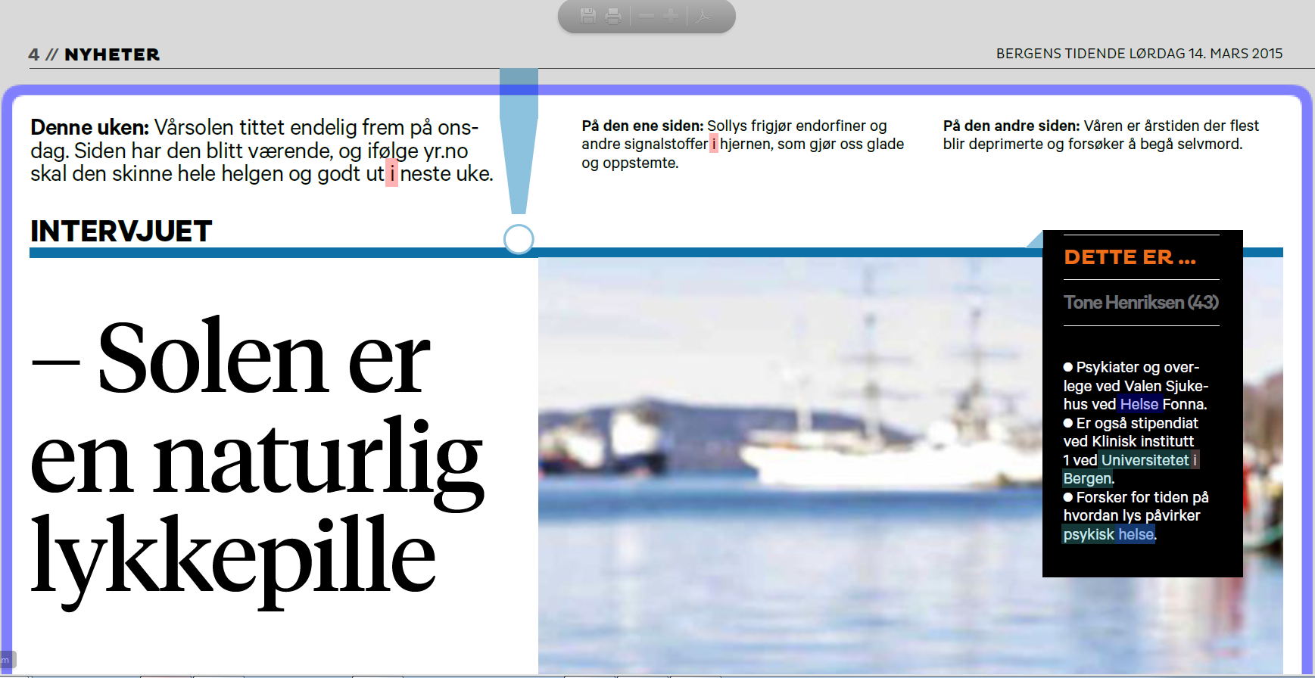
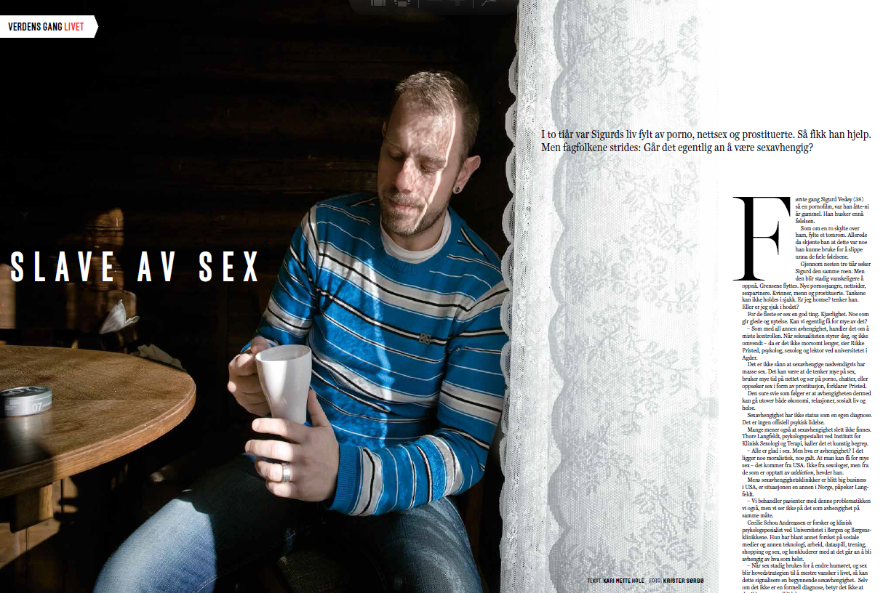
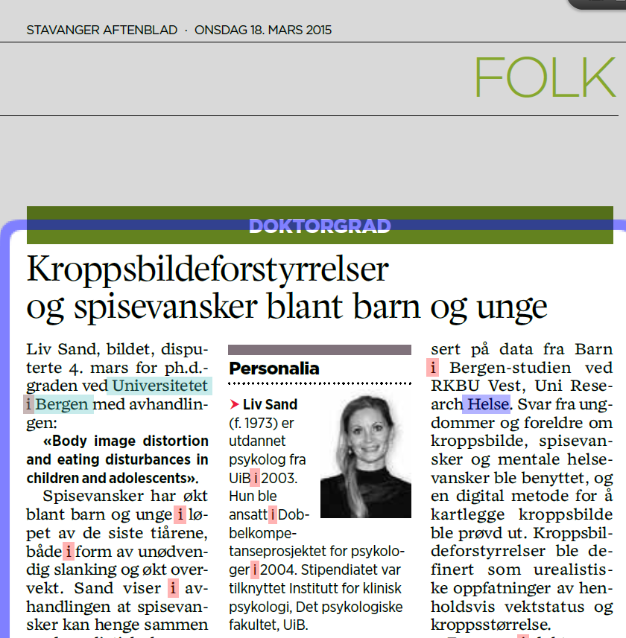
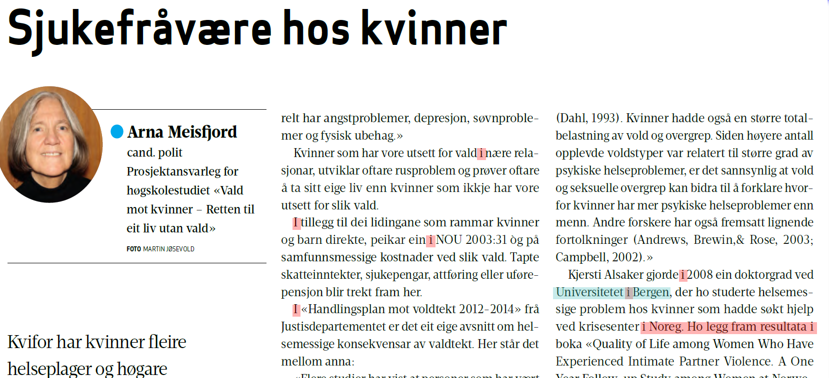
The «one-to-many» principle
Examples from UiB (March 2015)

Slide 18
The «one-to-many» principle
Write yourself
«Safe» starting point
Know your audience and keep it simple
Every researcher wants to have her opinion piece in Aftenposten?
Opinion piece (kronikk)
Debate article
Popular magazine article

Slide 19
The «one-to-many» principle
Participate in debates in your field
of research
live or through media:
Debatten
Dagsnytt 18
Aktuelt (which is sadly soon no more)

Slide 20
The «one-to-many» principle
Make a film/be a talking head
Example UiB: https://www.youtube.com/watch?v=Wi2u12aVuYc
Anxiety treatment using internet, Department of Clinical Psychology (target group?)
Example CICERO: http://klimafilm.no/ (high school students)
What do we know about climate change
Example NIPH: https://vimeo.com/110120394#at=0
An introduction to the Norwegian Mother and Child Cohort Study (short version (3,5 min. – English subtitles, used in conferences. Long version (8 min. made for participants in the study )
Web workplace,
social media
YouTube, Vimeo

Slide 21
Push and pull communication channels
Push channels
Social media: Decide what you want to communicate in the different social media
Private on facebook/professional on twitter?
Research blog: you may reach further than a reseach paper in a journal
Pull channels
www.uib.no

Slide 22
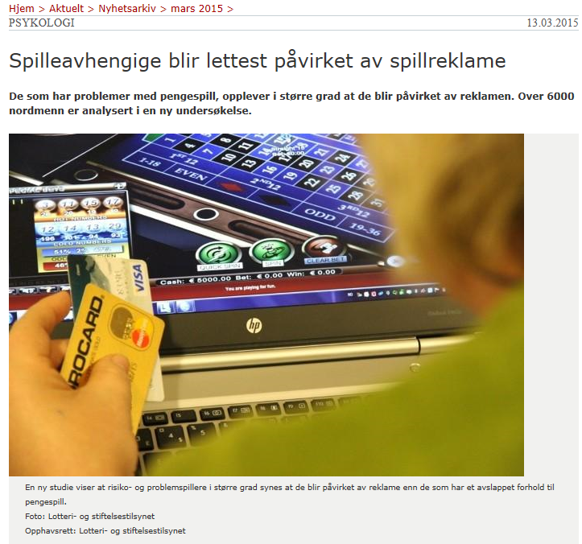
Push and pull communication channels
Fra nettsider UiB, mars 2015

Slide 23
When to use the Interactive Communication Model
The «one to one/one to group/group to group» principle
Tailoring vs high street clothing
Both parties enhance understanding and acquire new knowledge (extension of shared field)

Slide 24
When to use the Interactive Communication Model
Laymen conferences: Norwegian Board of Technology (Teknologirådet) and The Norwegian Biotechnology Advisory Board (Bioteknologirådet)
«Citizen science»
Research projects with user participation
Notes:
Two examples of layman registries:
Oberservation of species: artsobservasjoner.no
side effects of cosmetics registry

Slide 25
When to use the Interactive Communication Model
Public hearings
Round table talks and debates
Popular seminars/conferences and meetings
Short briefs: Politicians invite researchers to discuss current topics
Social media and interactive web meets (Twitter: journalists, polititicians, decision makers)

Slide 26
When to use the Transactional Communication Model
Transactional (from latin): force something to happen

Slide 27
When to use the Transactional Communication Model
Climate researchers – activists for change?
Blog: RealClimate www.realclimate.org
«RealClimate is a commentary site on climate science by working climate scientists for the interested public and journalists. We aim to provide a quick response to developing stories and provide the context sometimes missing in mainstream commentary. The discussion here is restricted to scientific topics and will not get involved in any political or economic implications of the science”
Sometimes accused of mixing politics and science

Slide 28
When to use the Transactional Communication Model
«One to one» interaction principle
«Face to Face» communication – the richest communication channel (Media richness theory, Daft and Lengel)
The more ambiguous and uncertain a task is, the richer the format of media that suits it

Slide 29
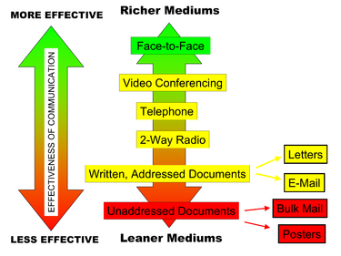
When to use the Transactional Communication Model
Media richness theory: Daft and Lengel

Slide 30
Communication within the framework of their workplace
The university-setting is encouraging science communication (building democracy)
However, few incentives to communicate
The ethics of communication (The Norwegian National Research Ethics Committees)
Guidelines for research ethics in the social sciences, law and the humanities
Notes:
Intellectiual curiosity – the atom bomb – democracy building § 100 in the Constitution – cultural traditions – informed public opinion – te community has made fomidable investments in research and should benefit from the results!

Slide 31
Communication within the framework of their workplace

Slide 32
Communication within the framework of their workplace
Pitfalls:
Helsinki declaration: Communicate both positive and negative results
Be alert when talking to journalists
State conflicts of interest
Be up front with financing
Be sincere as to the robustness of your findings
Especially when the results may have large societal implications

Slide 33
What about the researcher as as a member of civil society communicating outside her own research area?
«
To be continued and discussed………..

Slide 34
Take home messages
Researchers have an obligation to communicate science outside the academic community
Use all communication models (it is not a defeat to use the linear dissemination model)
Use the model that suits the target group, the message, the situation and the resources available to you
Start with something you like and master

Slide 35
Take home messages
Practise makes master
Consider using social media to communicate your research
Talk to people if you can – don’t email them (media richness theory)
The ethics of science communication
When outside your research area – you are a layman in the public debate

Slide 36
Thank you very much and good luck with your science communications efforts!
Tove Kolset mobile 977 63 198/email tove.kolset@fhi.no

